Slide 1


NCBDDD DCDD
Teratogens Identification: Data Science Support
Exploratory Analysis

Slide 2
Deloitte Work Week of 4/11/16
Accomplishments
Received the full data set (to date)!
Joined the data into one csv file using existing relationship mapping
Started exploratory analysis
Recommendation for matching
Set up github public repository

Slide 3
Teris Ratings Summary
Method – Count of unique values in the mag variable in the Teris summary table – Number of Agents = 1662
Value | Count | Percent of Total | Cumulative Percent
UNDETERMINED | 1260 | 75.8% | 75.8%
UNLIKELY | 195 | 11.7% | 87.5%
NONE | 51 | 3.1% | 90.6%
MINIMAL | 19 | 1.1% | 91.8%
SMALL TO MODERATE | 14 | 0.8% | 92.6%
NONE TO MINIMAL | 11 | 0.7% | 93.3%
FIRST-TRIMESTER USE: UNDETERMINED USE LATER IN PREGNANCY: SMALL TO MODERATE | 7 | 0.4% | 93.7%
HIGH | 6 | 0.4% | 94.0%
MINIMAL TO SMALL | 5 | 0.3% | 94.3%
MODERATE TO HIGH | 4 | 0.2% | 94.6%
Other | 90 | 5.4% | 100.0%
Interpretation – A large number of drugs labeled undetermined
We may have to combine some categories if we want to use Teris to validate findings or run supervised learning using Teris Mag values

Slide 4
Agent Description Matches
Method – using the existing relationship mapping to determine what agents in Teris had full descriptions across the data sets
Agents Matching Based on Teris Agents | #
# of agent can find descriptions in 3 sources | 322
# of agent can find descriptions only in Shepherd and Teris | 38
# of agent can find descriptions only in reprotox and Teris | 785
# of agent can’t find in Shepherd and reprotox | 517
Interpretation:
~70% Teris agent could find more than one description. We can use them to fit the model and check the model performance. More matching of synames will add more data to the agents.

Slide 5
Synname Matching
Method – Teris synname matching across the Shepard and Reprotox data sets with the current structure
# of shepherd agent name (‘ShepAgentName’): 3631
# of shepherd agent name not matching synname: 3046
# of reprotox agent name (‘DgDrug’): 10610
# of reprotox agent name not matching synname: 7709
Interpretation:
Still a lot of information to be included. Following a suggested matching flow outlined on the next slide with Teris agentname directly or if the shephard/reprotox agent name/syn

Slide 6
Suggested Matching Flow
Method -
Step | Description | Reason | Data
1 | Original Diagram | Intuitive Matching | Full Data Set
2 | Match ‘ReprotroxAgents DgDrug‘ to ‘terisSummaries agentname’ | Extra Matching that is Automated | Unmatched from step 1
3 | Match ‘shepardAgents Syn’ to ‘TerisAgents Synname’ | Extra Matching that is Automated | Unmatched from step 2
4 | Match ‘shepardSummaries Agentname’ to ‘terisSummaries agentname’ | Extra Matching that is Automated | Unmatched from step 3
5 | Stem word matching – requires manual checks | Automated matching exhausted – manual checking | Unmatched from step 4
6 | Probability matching – requires manual checks | Automated matching exhausted – manual checking | Unmatched from step 5

Slide 7
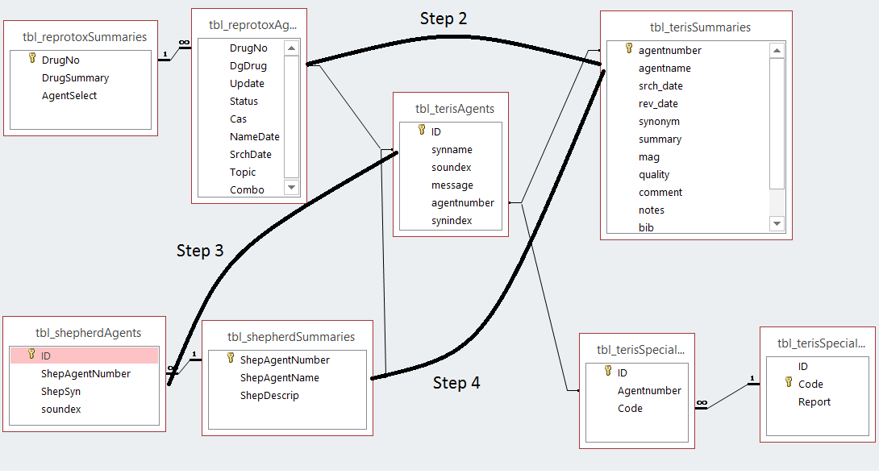
Suggested Matching Flow
Automated Steps

Slide 8
Questions
Can we include notes section from Teris for the data modeling
Match agreement

